Slide 1
Agile Development And Methodology
Name-Nikhil Kant Pandey

Slide 2
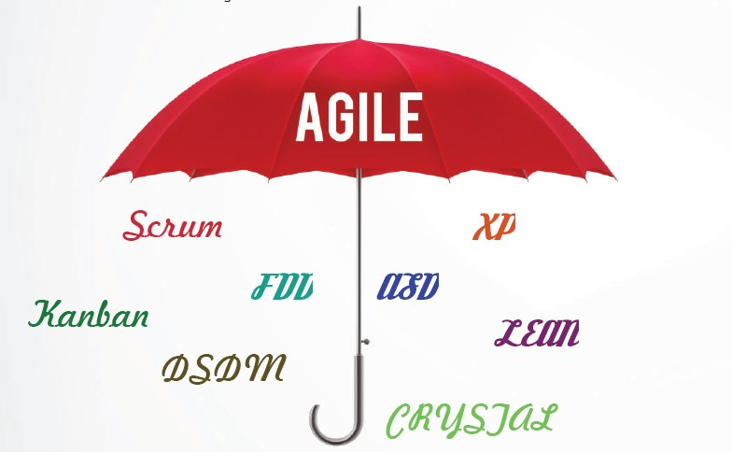

Slide 3
1. What is Agile ??
Agile is an iterative approach to project management and software development that helps teams deliver value to their customers faster and with fewer headaches. Instead of betting everything on a "big bang" launch, an agile team delivers work in small, but consumable, increments. Requirements, plans, and results are evaluated continuously so teams have a natural mechanism for responding to change quickly.

Slide 4
2 .Why Choose Agile
Teams choose agile so they can respond to changes in the marketplace or feedback from customers quickly without derailing a year's worth of plans. "Just enough" planning and shipping in small, frequent increments lets your team gather feedback on each change and integrate it into future plans at minimal cost.
But it's not just a numbers game—first and foremost, it's about people. As described by the Agile Manifesto, authentic human interactions are more important than rigid processes. Collaborating with customers and teammates is more important than predefined arrangements. And delivering a working solution to the customer's problem is more important than hyper-detailed documentation
An agile team unites under a shared vision, then brings it to life the way they know is best. Each team sets their own standards for quality, usability, and completeness. Their "definition of done" then informs how fast they'll churn the work out. Although it can be scary at first, company leaders find that when they put their trust in an agile team, that team feels a greater sense of ownership and rises to meet (or exceed) management's expectations.

Slide 5
Principle Of Agile
Customer Satisfaction
Welcome Change
Delivery Working Software
Colloboration
Motivation
Face to Face Conversation
Measure the progress as per the working software
Maintain Constant Pace
Monitoring
Simplicity
Self-Organized Teams
Review the work regularly

Slide 6
Agile work
Scrum
Kanban
Project Management
Software Development
Product Management
Teams
Develops
We were show you some working model just like –Scrum,Kanban.

Slide 7
Scrum
Scrum is one of the most popular frameworks for implementing agile. So popular, in fact, that many people think scrum and agile are the same thing. (They're not.) Many frameworks can be used to implement agile, such as kanban for example, but scrum has a unique flavor because of the commitment to short iterations of work.
With scrum, the product is built in a series of fixed-length iterations called sprints that give teams a framework for shipping software on a regular cadence. Milestones–i.e., the end of a sprint–come frequently, bringing with them a feeling of tangible progress with each cycle that focuses and energizes everyone. ("Continuous inspiration" for the win!) Short iterations also reinforce the importance of good estimation and fast feedback from tests–both recurring struggles in waterfall projects
Scrum calls for four ceremonies that bring structure to each sprint :
A) Sprint planning
B) Daily stand-up
C) Sprint demo
D) Sprint retrospective

Slide 8
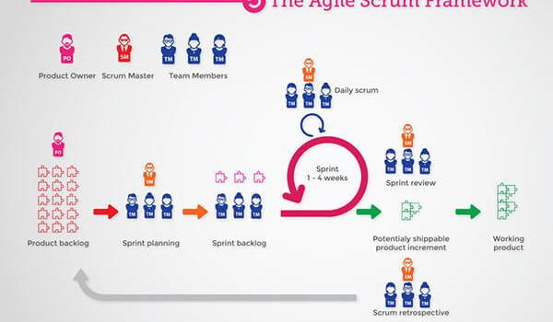
Scrum Framework Agile

Slide 9
Kanban
Kanban is a popular framework used to implement agile software development. It requires real-time communication of capacity and full transparency of work. Work items are represented visually on a kanban board, allowing team members to see the state of every piece of work at any time.

Slide 10
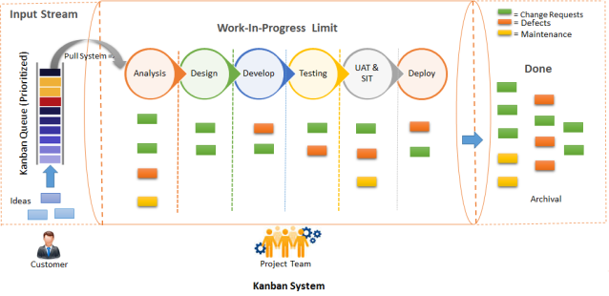
Notes:
Kanban System Model.

Slide 11
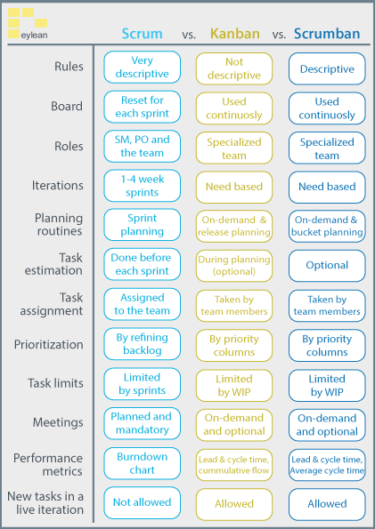
Scrum Vs Kanban

Slide 12
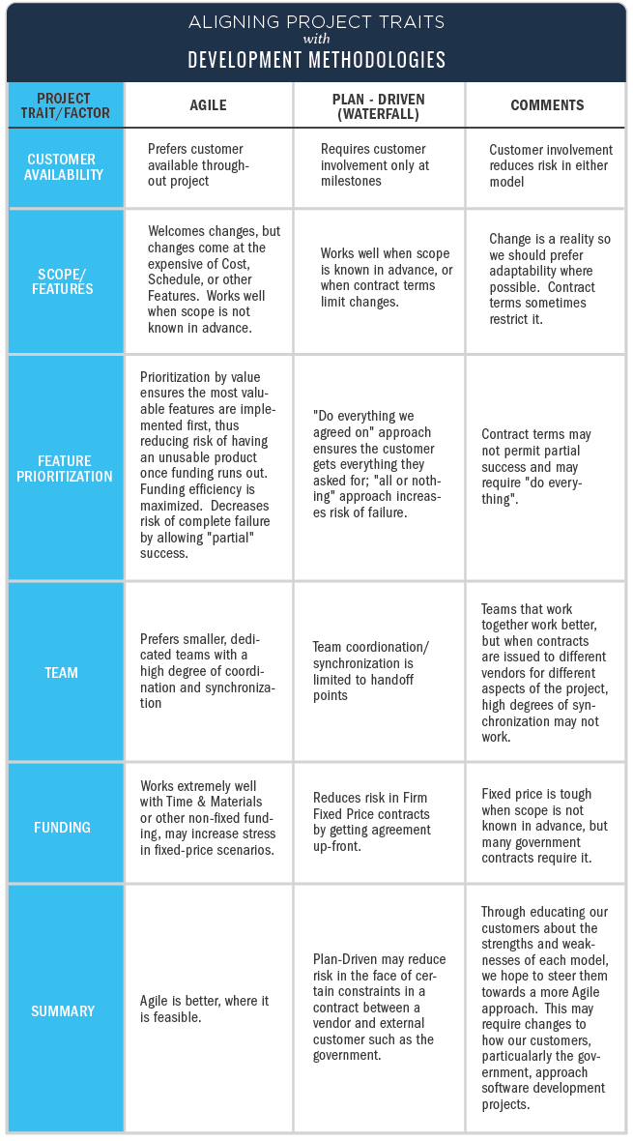

Slide 13
Git Use Agile Methodology
Git -Git is a revision control system, a tool to manage your source code history. GitHubis a hosting service for Git repositories. So they are not the same thing: Git is the tool, GitHub is the service for projects that use Git. To get your code to GitHub, have a look here
We were use zenhub to create agile in git ..
Notes:
We Were Given Some Example for Agile Methodology Using Git ….

Slide 14
Zenhub Use in Git
Zenhub-ZenHub is the only project management tool that integrates natively within GitHub's user interface. ... Developers stay in an environment they love, and Project Managers get total visibility into the development process.

Slide 15
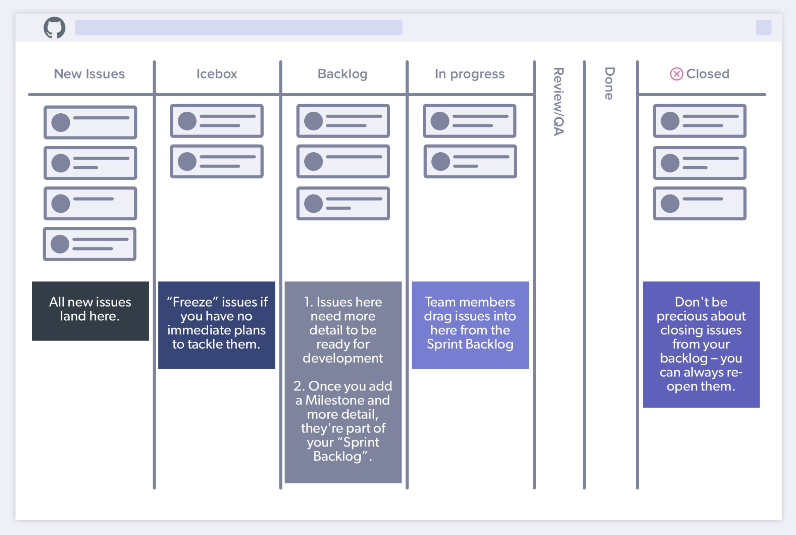
Notes:
Zenhub Model and Flow structure and his work……

Slide 16
Some Famous And Useful Tools
Jira Tool-JIRA is a tool developed by Australian Company Atlassian. It is used for bug tracking, issue tracking, and project management. The name "JIRA" is actually inherited from the Japanese word "Gojira" which means "Godzilla".
The basic use of this tool is to track issue and bugs related to your software and Mobile apps. It is also used for project management. The JIRA dashboard consists of many useful functions and features which make handling of issues easy. Some of the key features are listed below. Let's learn JIRA Defect and Project tracking software with this Training Course.

Slide 17
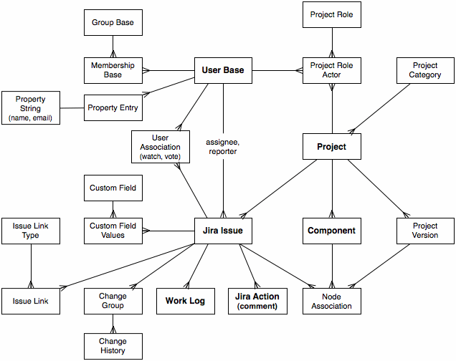
Jira Data Model

